Slide 1

ODYSSEAN CARTOGRAPHERS'
Anvit Pawar
Anya Gupta
Pushkar Tuse
SRMIST, KTR

Slide 2
PROBLEM STATEMENT
TARGET AUDIENCE
MARKET GROWTH
FEATURES
PROTOTYPE
PROCESS FLOW
TECHNICAL STACK
SCALABILITY
MEET OUR TEAM

Slide 3
PROBLEM STATEMENT
TARGET AUDIENCE
MARKET GROWTH
FEATURES
PROTOTYPE
PROCESS FLOW
TECHNICAL STACK
SCALABILITY
MEET OUR TEAM

Slide 4



PROBLEM STATEMENT
The absence of robust indoor-outdoor navigation tools

Slide 5
PROBLEM STATEMENT
TARGET AUDIENCE
MARKET GROWTH
FEATURES
PROTOTYPE
PROCESS FLOW
TECHNICAL STACK
SCALABILITY
MEET OUR TEAM

Slide 6
PROBLEM STATEMENT
TARGET AUDIENCE
MARKET GROWTH
FEATURES
PROTOTYPE
PROCESS FLOW
TECHNICAL STACK
SCALABILITY
MEET OUR TEAM

Slide 7
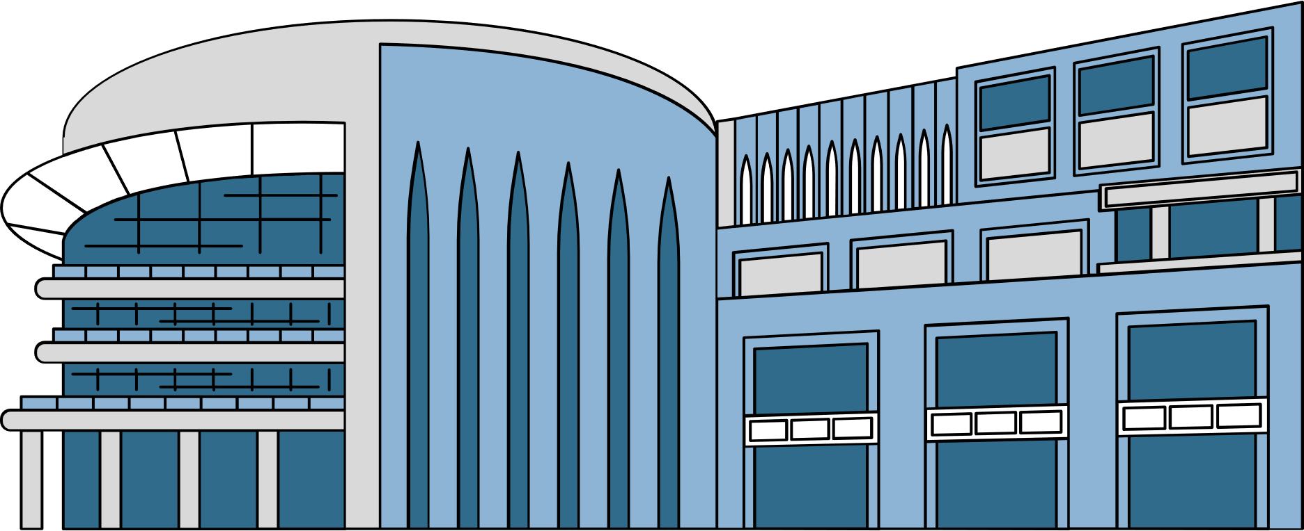


TARGET AUDIENCE
Professionals navigating large enclosed campus

Slide 8
PROBLEM STATEMENT
TARGET AUDIENCE
MARKET GROWTH
FEATURES
PROTOTYPE
PROCESS FLOW
TECHNICAL STACK
SCALABILITY
MEET OUR TEAM

Slide 9
PROBLEM STATEMENT
TARGET AUDIENCE
MARKET GROWTH
FEATURES
PROTOTYPE
PROCESS FLOW
TECHNICAL STACK
SCALABILITY
MEET OUR TEAM

Slide 10

258
150.53B
2022
836
836
836
571
357.24B
2032
385
Predicted Growth Rate (USD)
Source: The New York Times
MARKET GROWTH
2027
2028
2029
2030

Slide 11
PROBLEM STATEMENT
TARGET AUDIENCE
MARKET GROWTH
FEATURES
PROTOTYPE
PROCESS FLOW
TECHNICAL STACK
SCALABILITY
MEET OUR TEAM

Slide 12
PROBLEM STATEMENT
TARGET AUDIENCE
MARKET GROWTH
FEATURES
PROTOTYPE
PROCESS FLOW
TECHNICAL STACK
SCALABILITY
MEET OUR TEAM

Slide 13

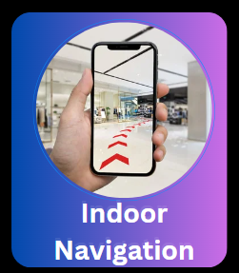

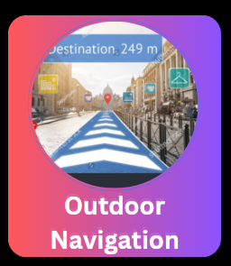
FEATURES

Slide 14
FEATURES

Slide 15
FEATURES

Slide 16
FEATURES

Slide 17
PROBLEM STATEMENT
TARGET AUDIENCE
MARKET GROWTH
FEATURES
PROTOTYPE
PROCESS FLOW
TECHNICAL STACK
SCALABILITY
MEET OUR TEAM

Slide 18
PROBLEM STATEMENT
TARGET AUDIENCE
MARKET GROWTH
FEATURES
PROTOTYPE
PROCESS FLOW
TECHNICAL STACK
SCALABILITY
MEET OUR TEAM

Slide 19
PROTOTYPE

Slide 20
PROBLEM STATEMENT
TARGET AUDIENCE
MARKET GROWTH
FEATURES
PROTOTYPE
PROCESS FLOW
TECHNICAL STACK
SCALABILITY
MEET OUR TEAM

Slide 21
PROBLEM STATEMENT
TARGET AUDIENCE
MARKET GROWTH
FEATURES
PROTOTYPE
PROCESS FLOW
TECHNICAL STACK
SCALABILITY
MEET OUR TEAM

Slide 22
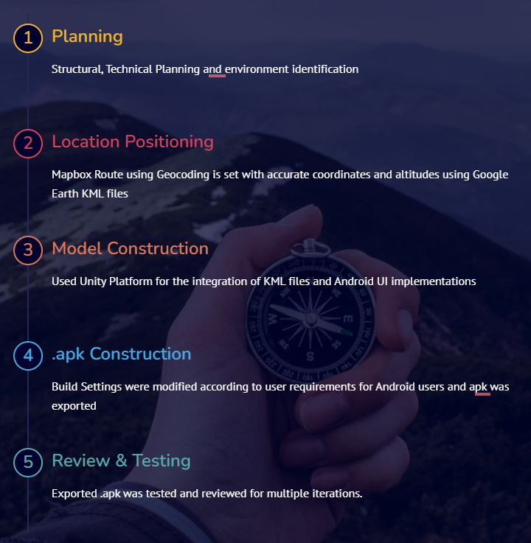
Process Flow

Slide 23
PROBLEM STATEMENT
TARGET AUDIENCE
MARKET GROWTH
FEATURES
PROTOTYPE
PROCESS FLOW
TECHNICAL STACK
SCALABILITY
MEET OUR TEAM

Slide 24
PROBLEM STATEMENT
TARGET AUDIENCE
MARKET GROWTH
FEATURES
PROTOTYPE
PROCESS FLOW
TECHNICAL STACK
SCALABILITY
MEET OUR TEAM

Slide 25
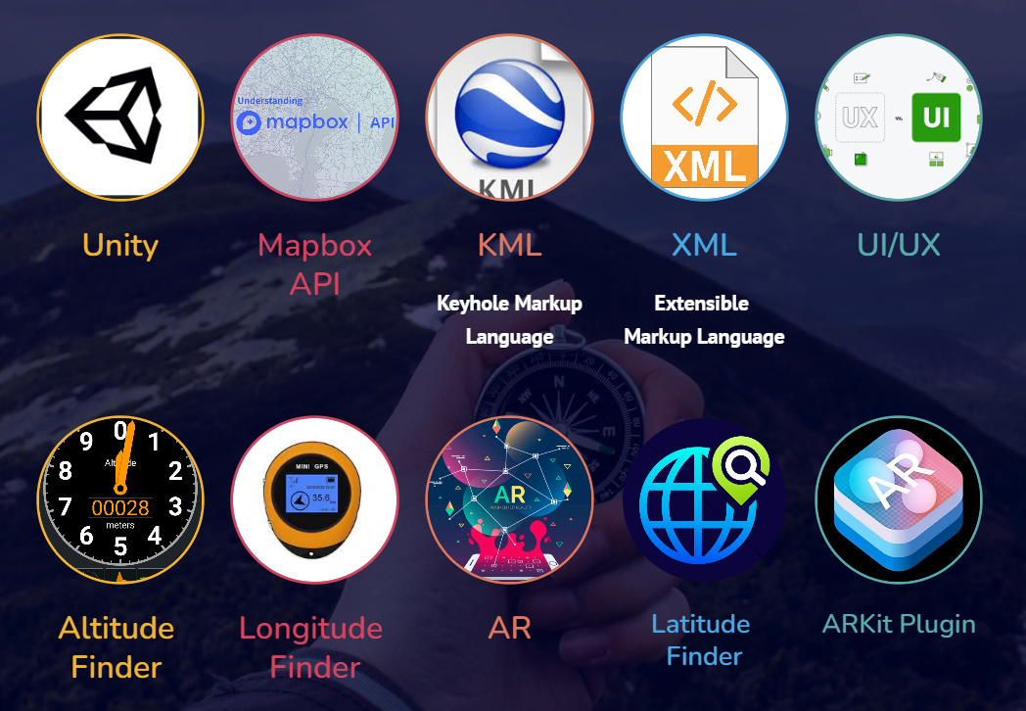
TECHNICAL STACK

Slide 26
PROBLEM STATEMENT
TARGET AUDIENCE
MARKET GROWTH
FEATURES
PROTOTYPE
PROCESS FLOW
TECHNICAL STACK
SCALABILITY
MEET OUR TEAM

Slide 27
PROBLEM STATEMENT
TARGET AUDIENCE
MARKET GROWTH
FEATURES
PROTOTYPE
PROCESS FLOW
TECHNICAL STACK
SCALABILITY
MEET OUR TEAM

Slide 28

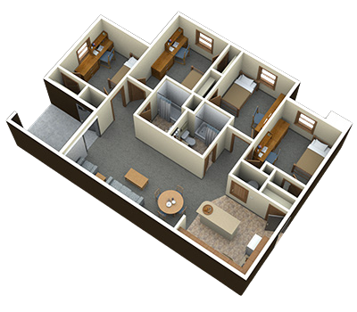

SCALABILITY
Automation through KML
3D Floor Plan Generation
Revenue Collection

Slide 29
PROBLEM STATEMENT
TARGET AUDIENCE
MARKET GROWTH
FEATURES
PROCESS FLOW
TECHNICAL STACK
SCALABILITY
MEET OUR TEAM

Slide 30
PROBLEM STATEMENT
TARGET AUDIENCE
MARKET GROWTH
FEATURES
PROCESS FLOW
TECHNICAL STACK
SCALABILITY
MEET OUR TEAM

Slide 31


THANK YOU

